Slide 1
Today
Intro to 360 Video
Shooting
Stitching (not required anymore)
Editing
Publishing
Assignment
Matchup
Emerging Tech

Slide 2
360 Video
How to Plan, Shoot and Distribute 360 Video

Slide 3
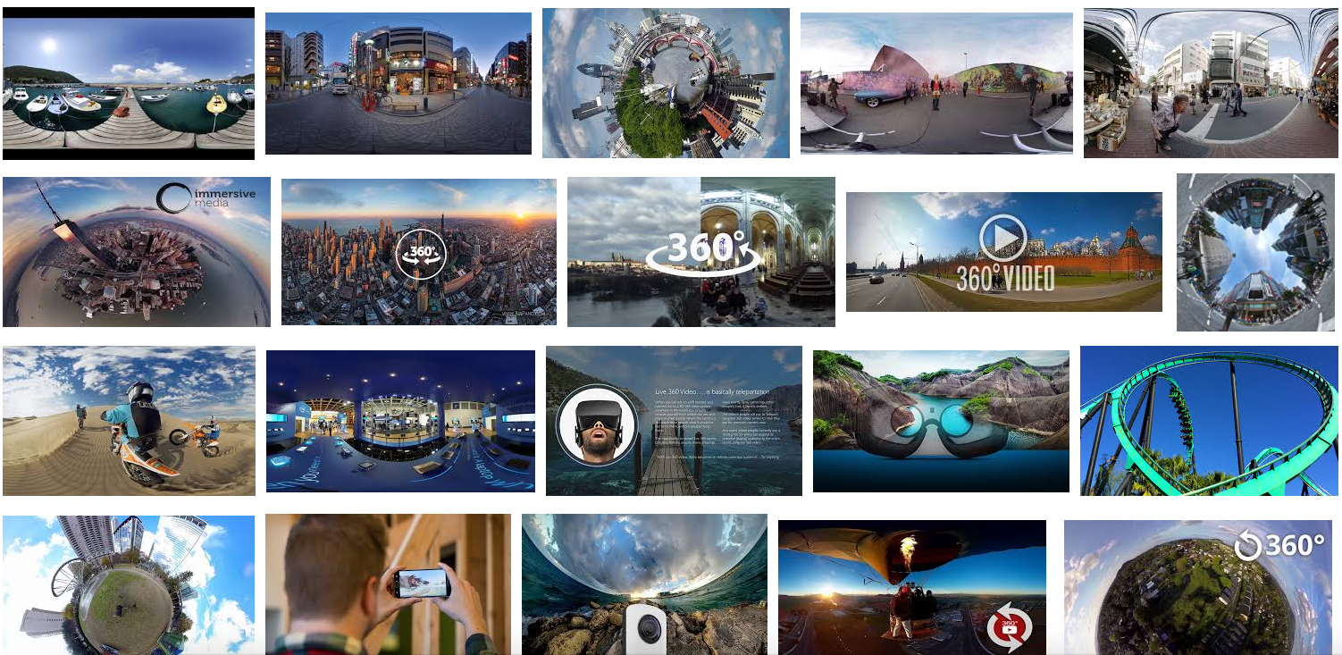

Slide 4
What is 360 Video or Immersive Video
Class Video
YouTube 360
https://www.youtube.com/360

Slide 5
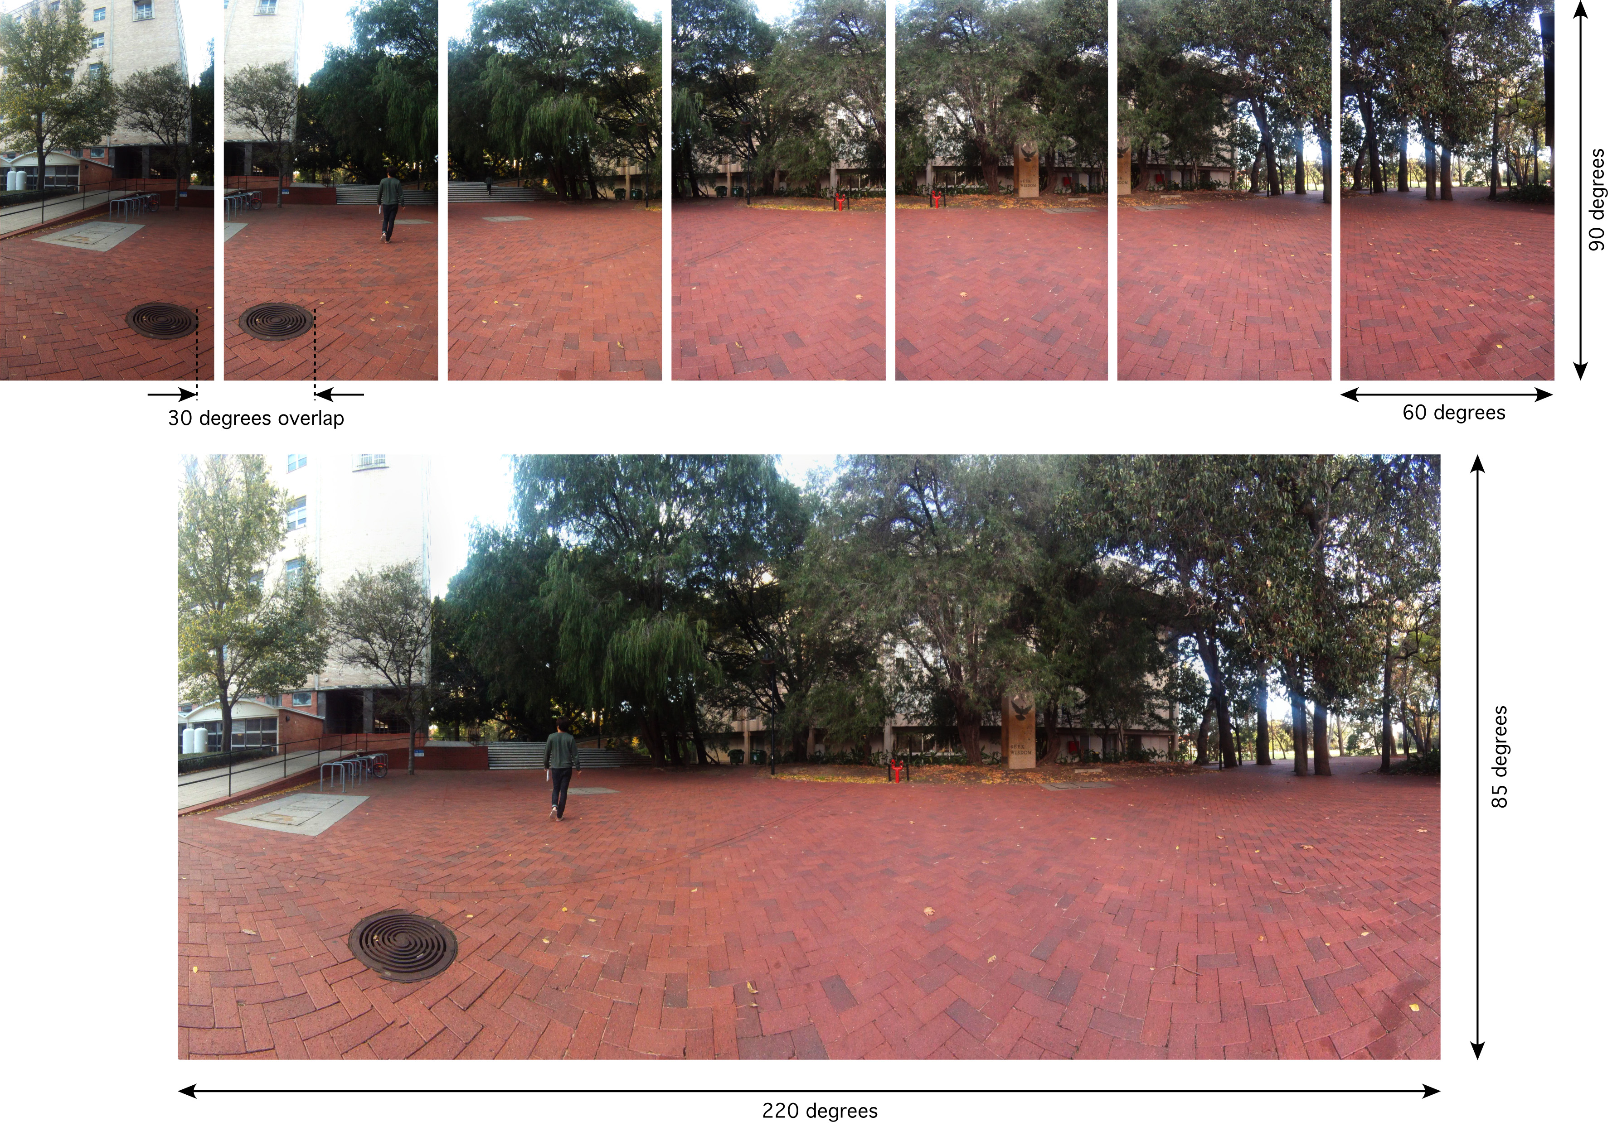
Multiple lenses and image sensors Stitched together

Slide 6
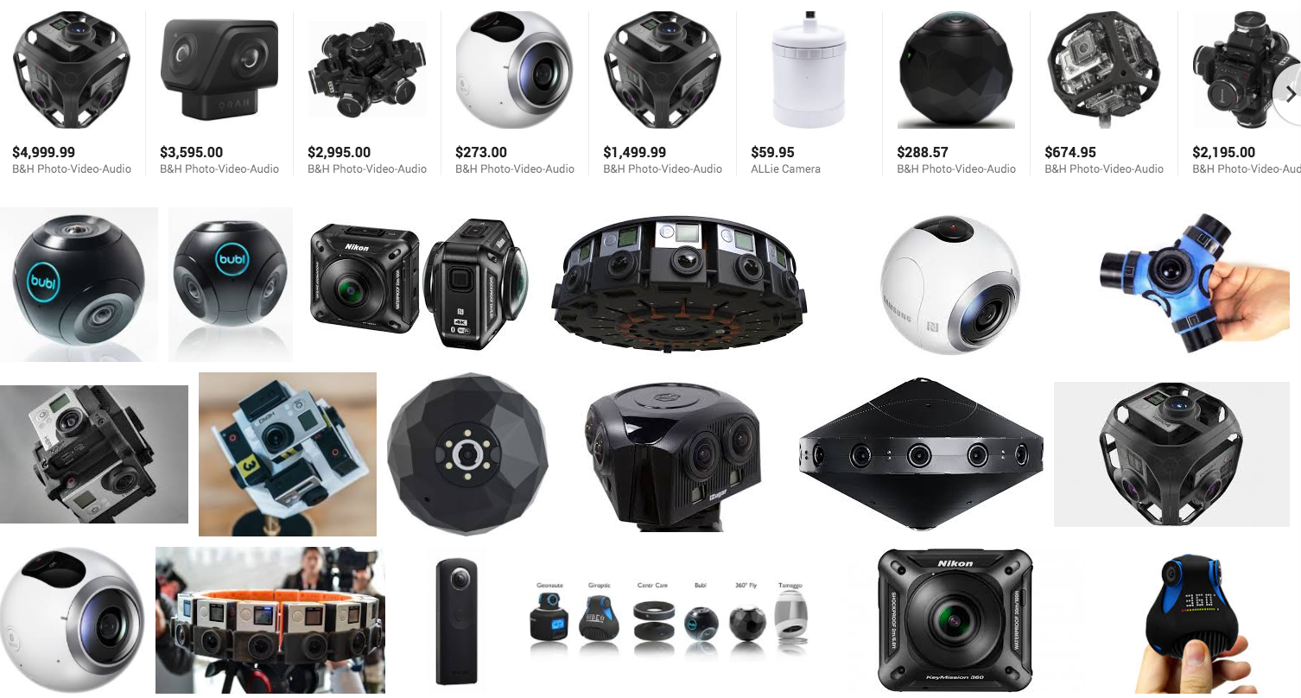
Cameras

Slide 7
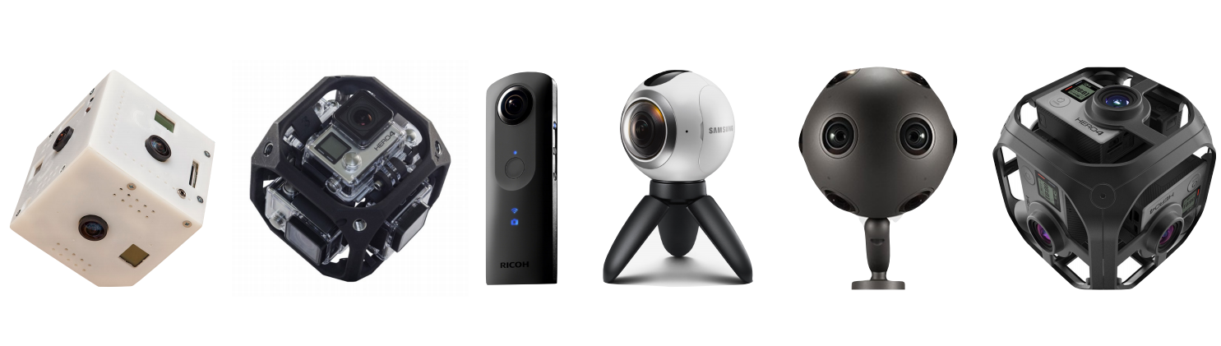
360 Cameras

Slide 8
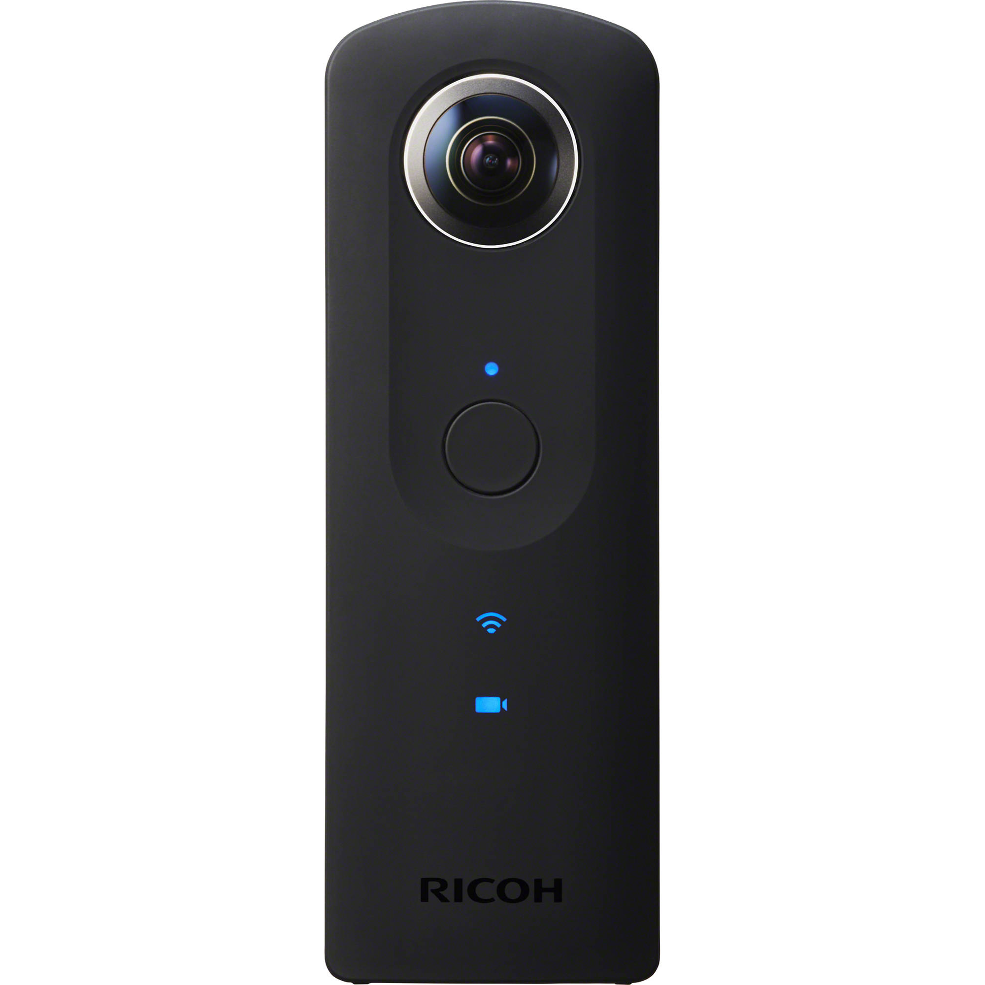
Theta S

Slide 9
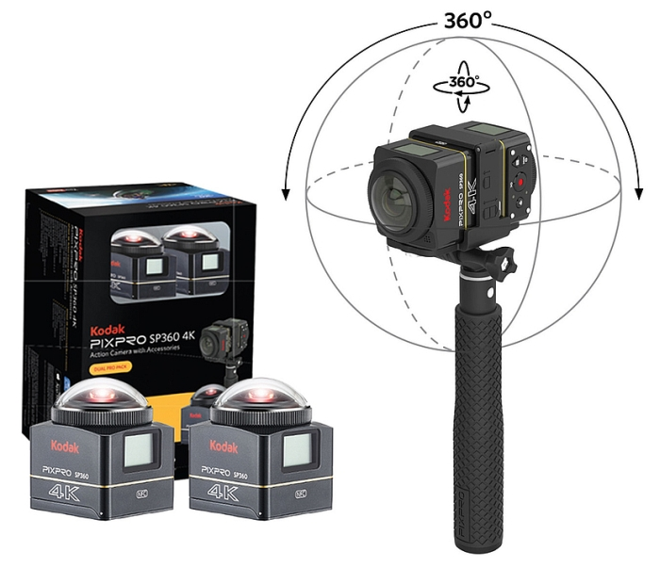
Kodak SP360

Slide 10
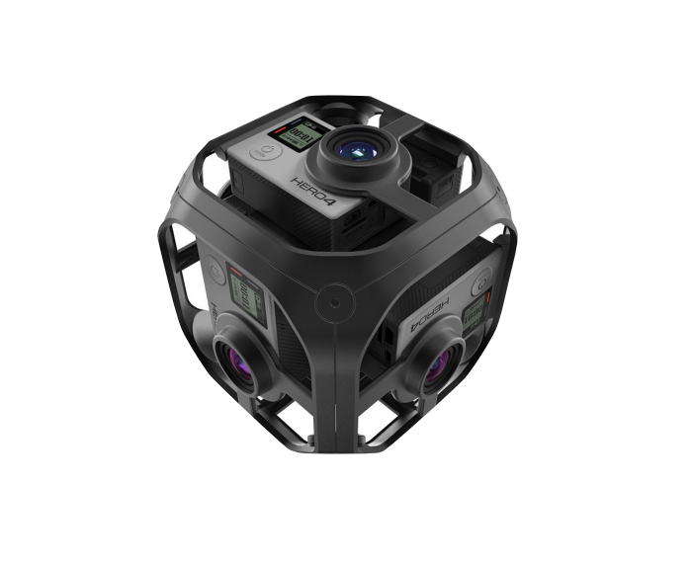
The Omni

Slide 11
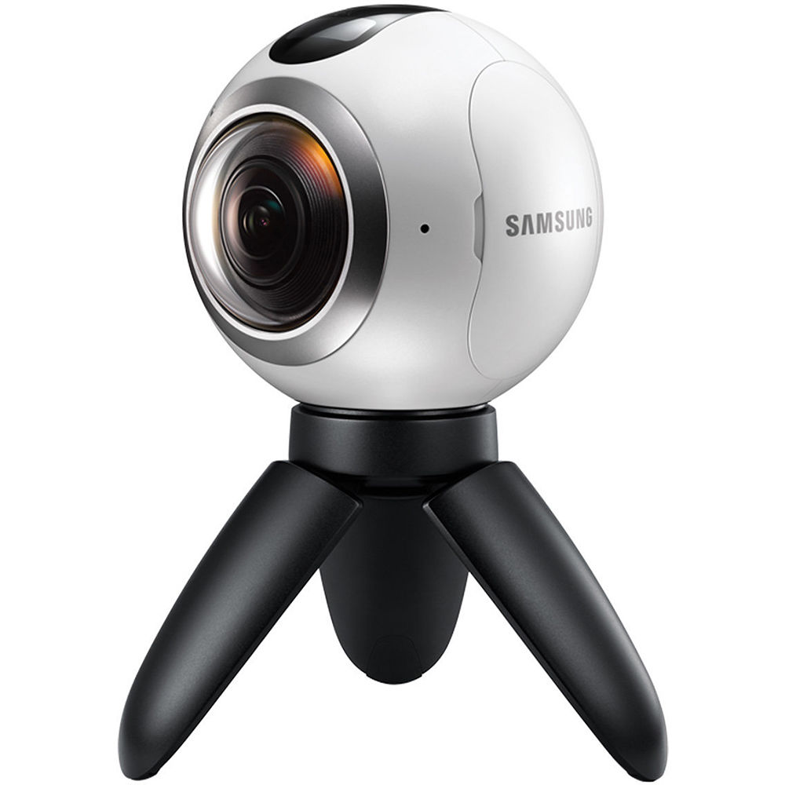
Samsung Gear 360

Slide 12
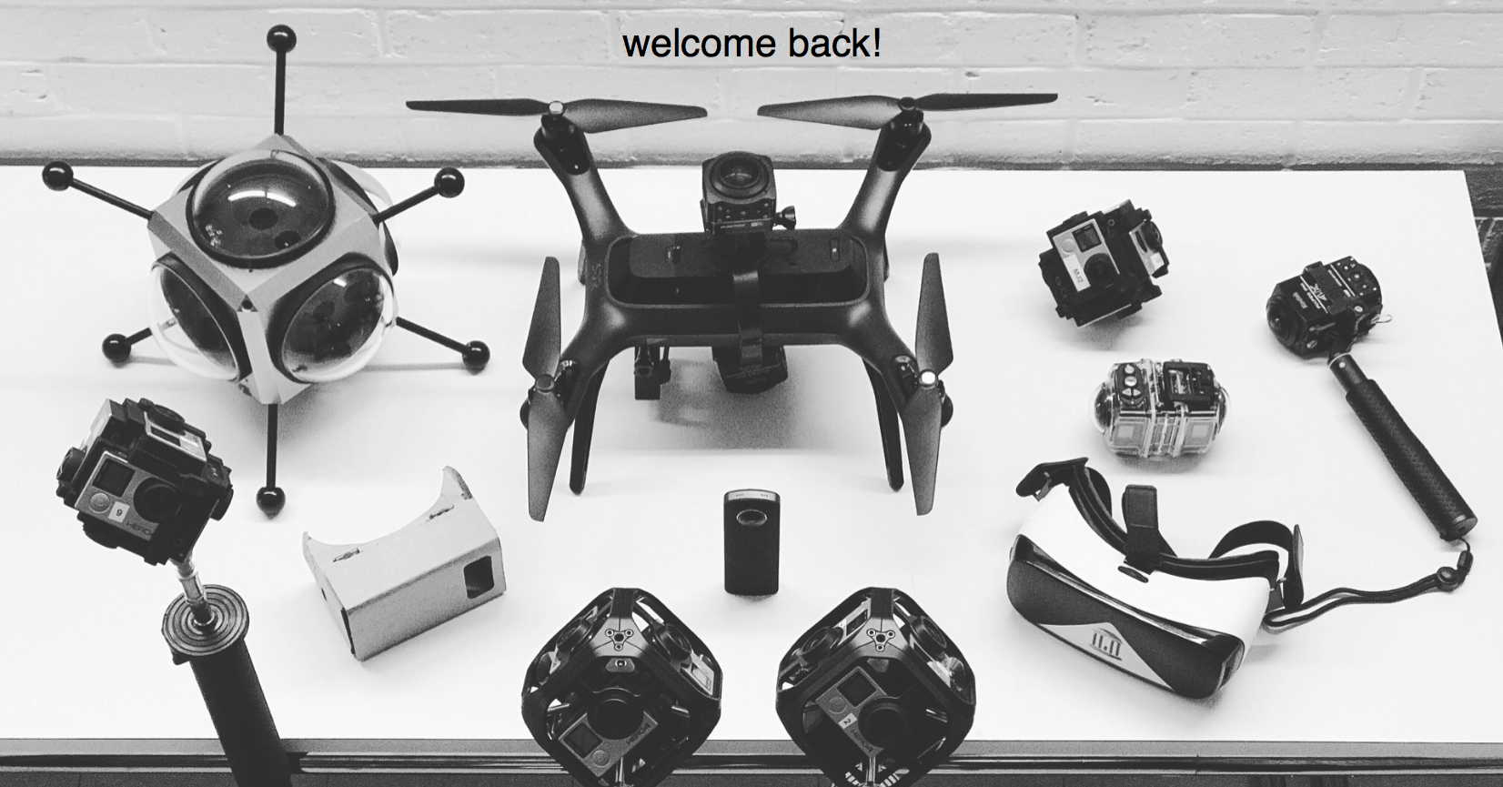

Slide 13
What makes a good 360 Video?

Slide 14
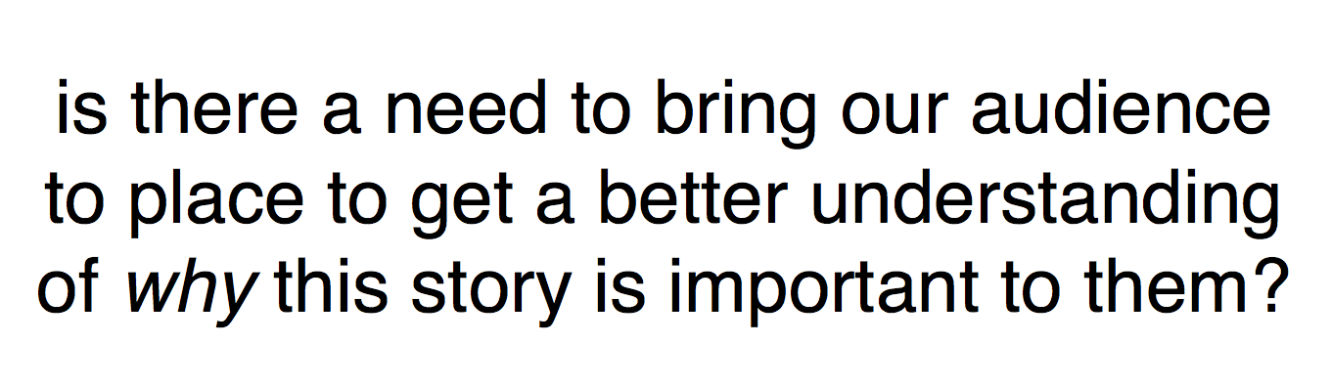

Slide 15
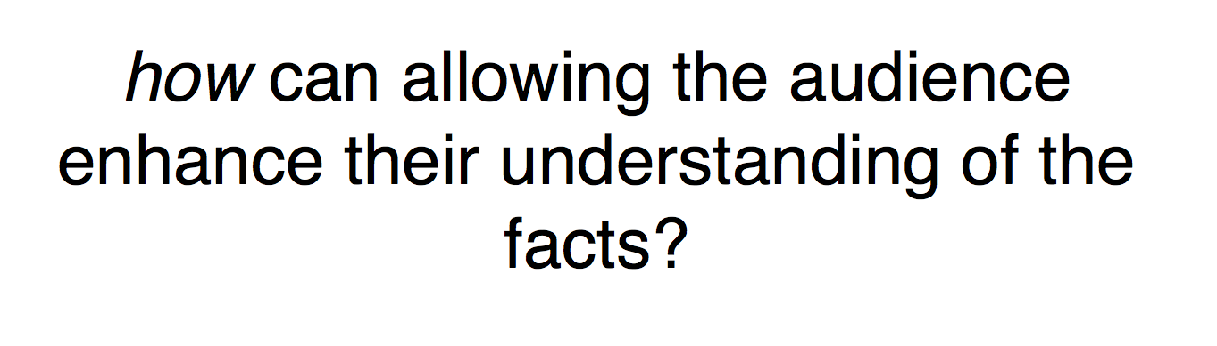

Slide 16
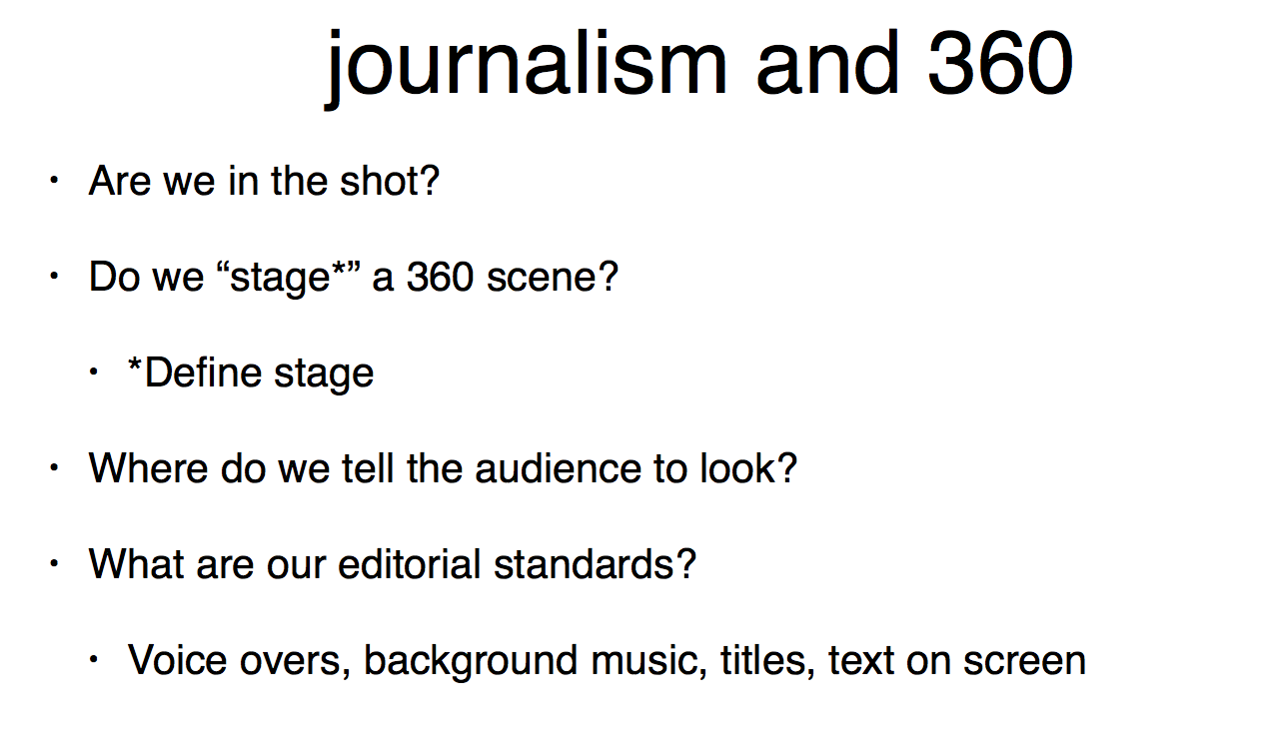

Slide 17
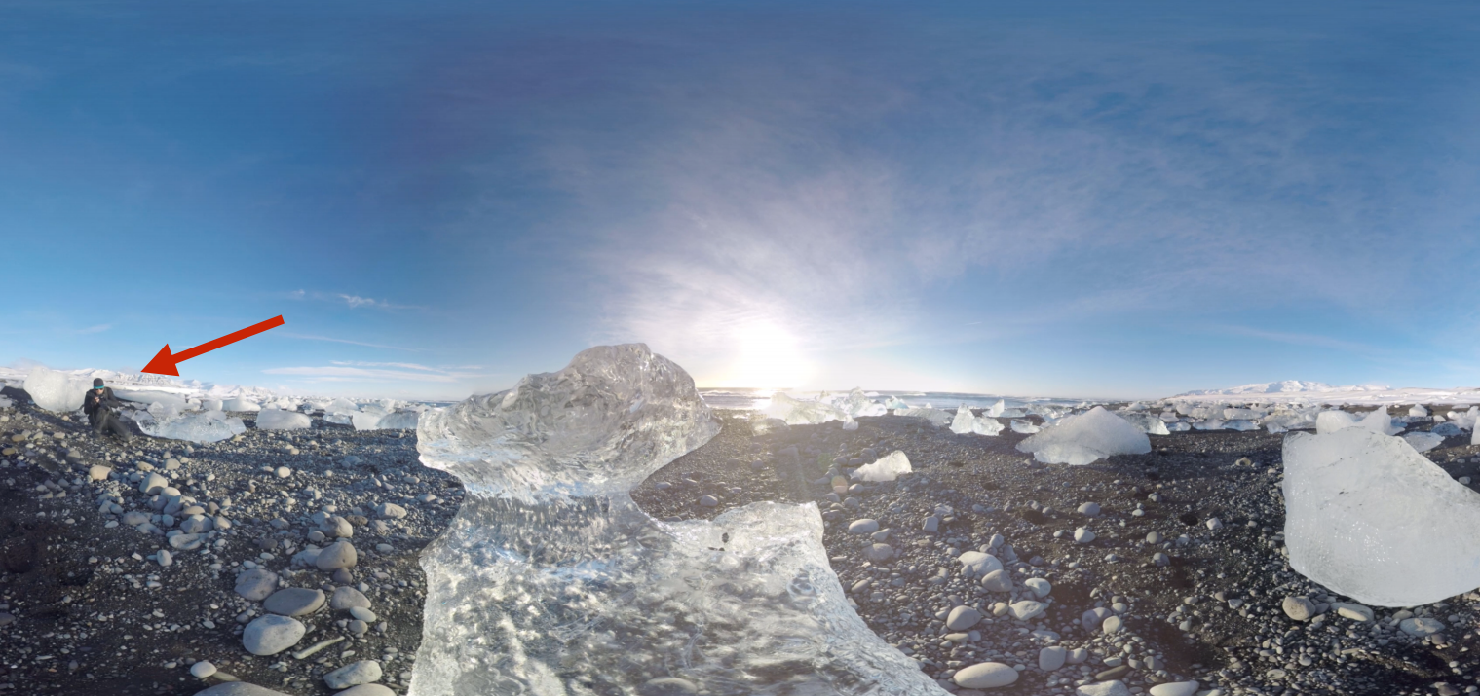

Slide 18
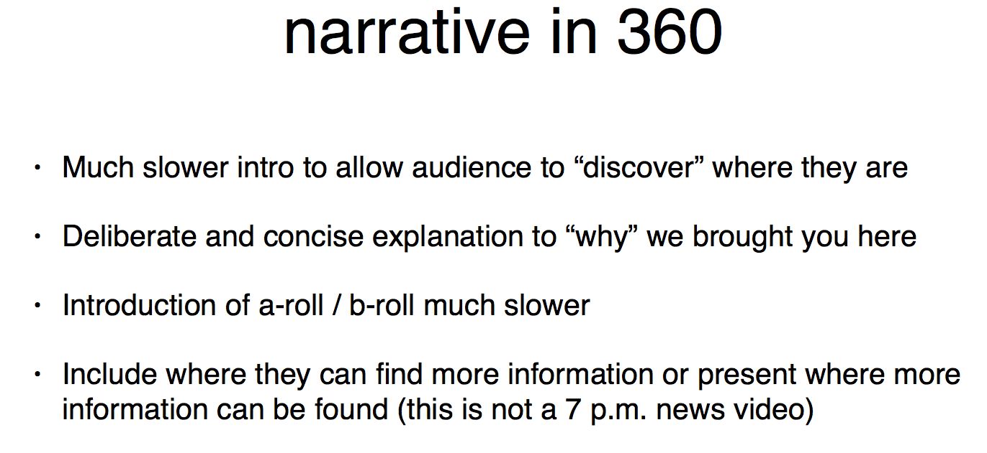

Slide 19


Slide 20


Slide 21
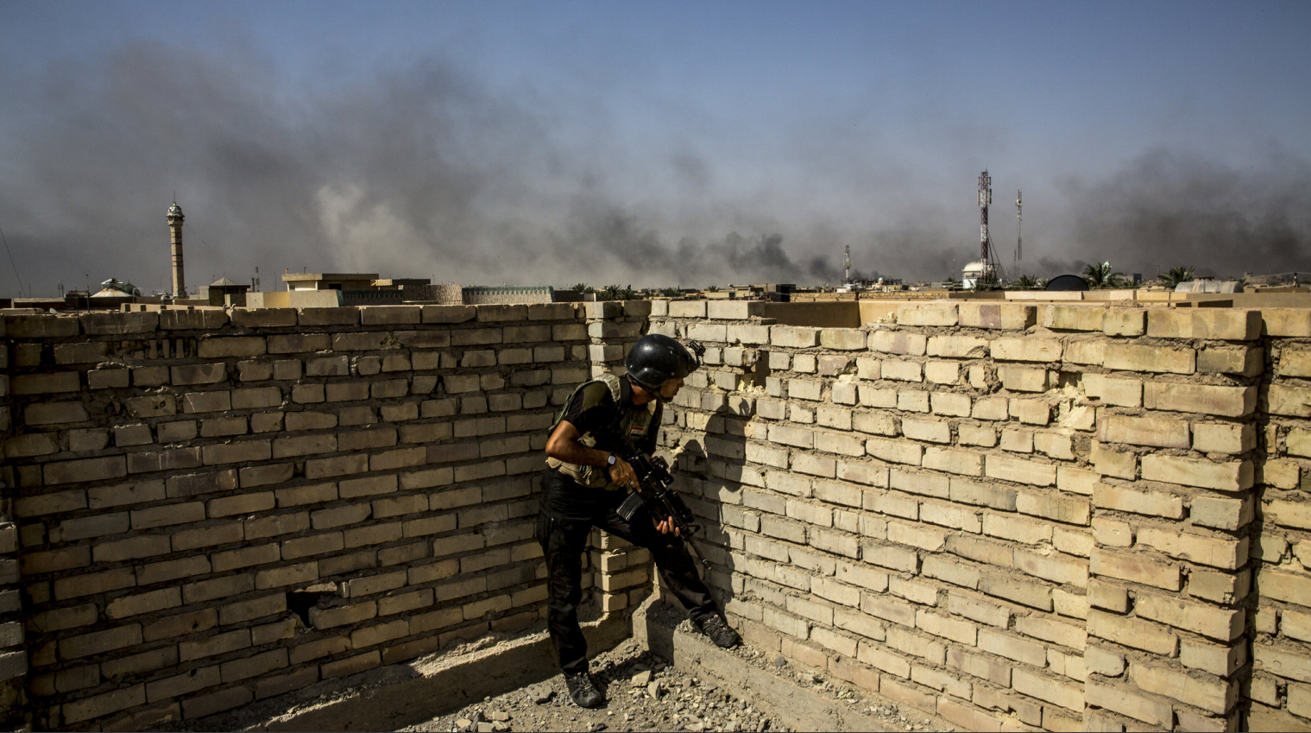

Slide 22


Slide 23
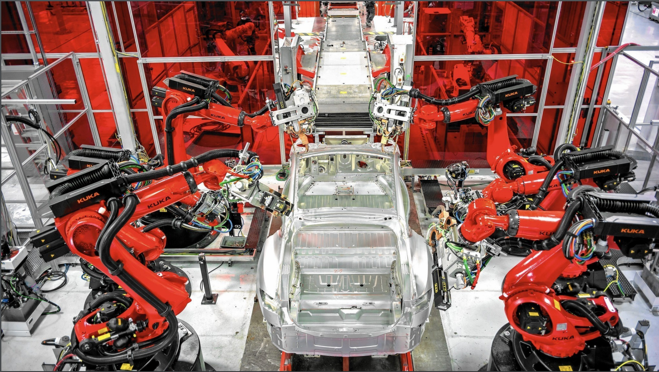

Slide 24


Slide 25


Slide 26


Slide 27


Slide 28


Slide 29


Slide 30
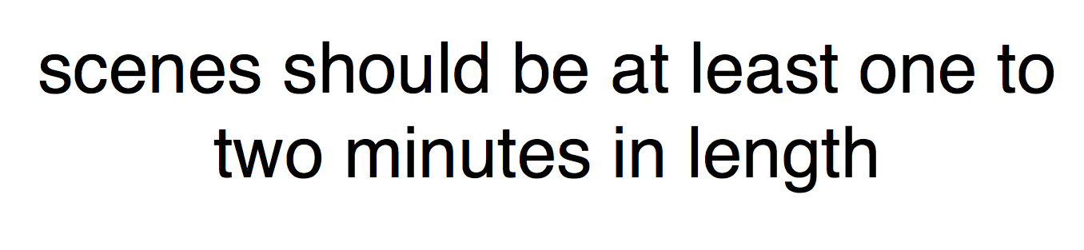

Slide 31


Slide 32
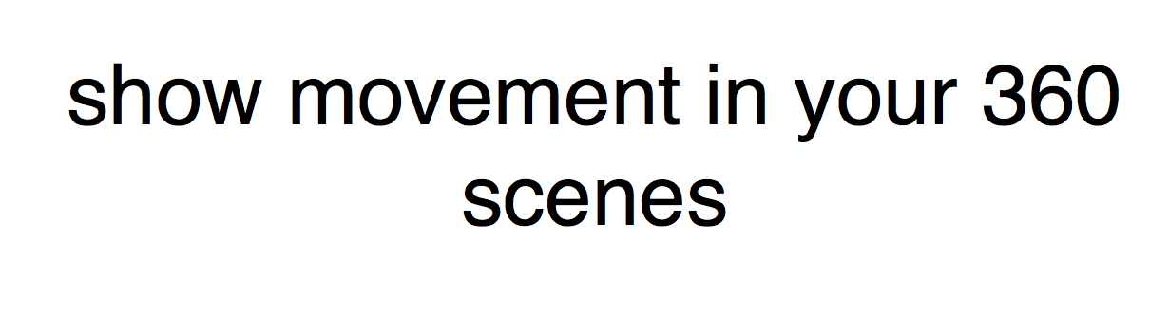

Slide 33


Slide 34
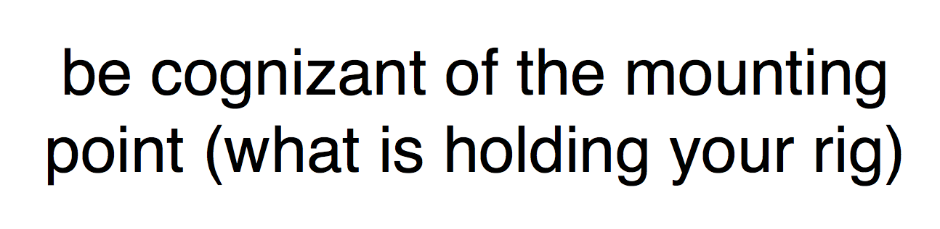

Slide 35
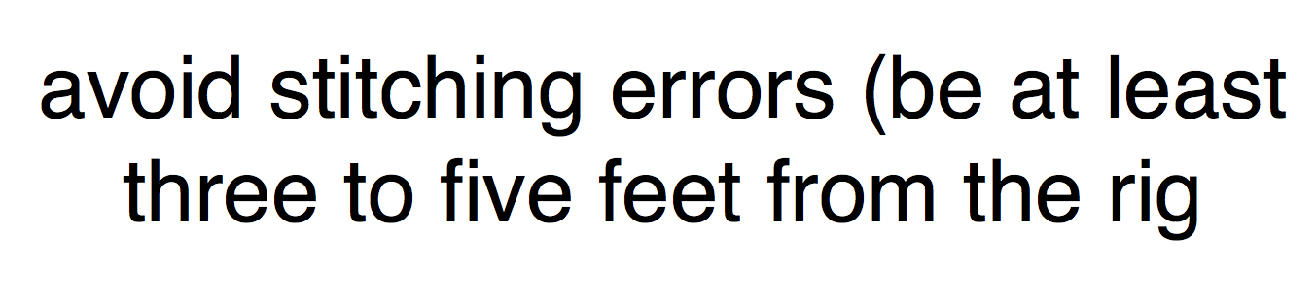

Slide 36
What Not to do!
https://www.youtube.com/watch?v=RWYKrePZwkM

Slide 37
Stitching
Theta https://theta360.com/en/support/download/
Kodak PixPro SP360 https://kodakpixpro.com/Europe/support/downloads.php
Omni http://www.kolor.com/autopano-video/download/
Samsung | https://www.muvee.com/for/360-video-stitcher-software-mac

Slide 38
Editing
Adobe Premier
or favorite editor.
GoPro Viewer

Slide 39
Publishing
YouTube 360
https://support.google.com/youtube/answer/6178631?hl=en
LittlStar

Slide 40
360 Video Assignment
Produce a 360 Video of an experience or situation that tells a story. The story can be first-person, narrator or or on-camera. It should be made of multiple shots and be at least 1 minute and not more than three minutes.
Check out the gear from UNC Gear Checkout.
Stitch, Edit and Post the video to YouTube360.
Submit the link as a comment on the assignment issue.

